Slide 1

Vaccine Doses Administered Per County

Slide 2
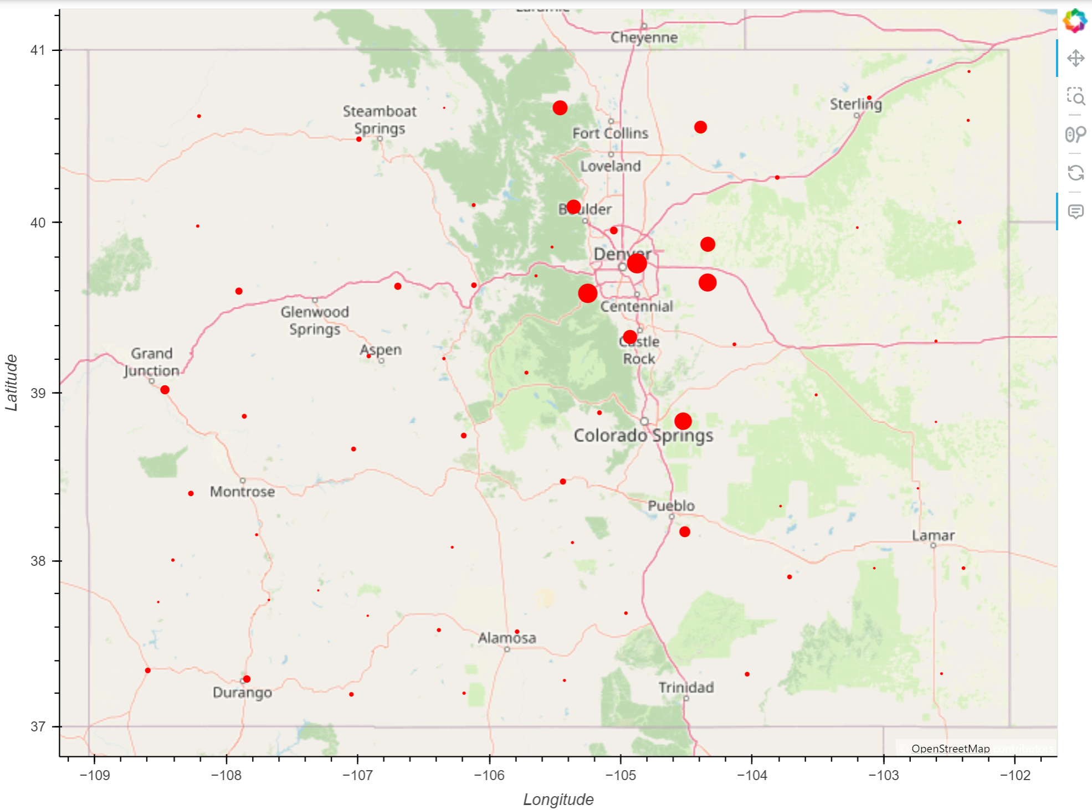
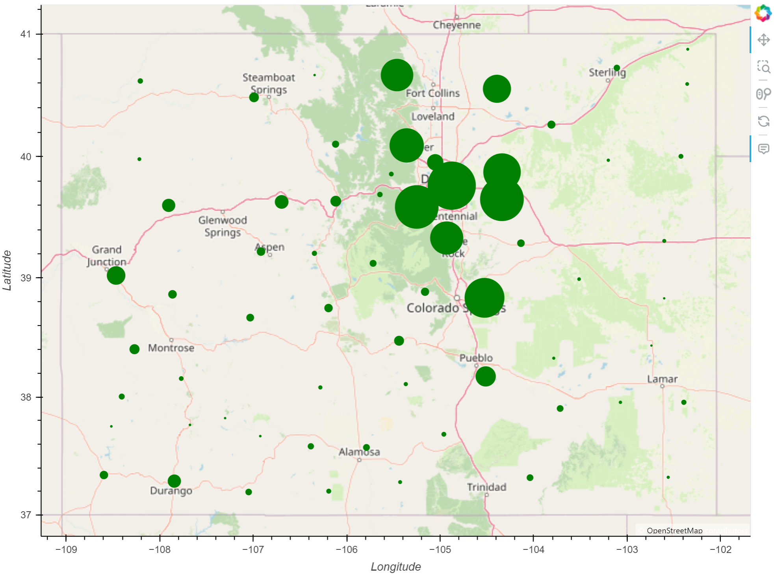
2020
2023
Notes:
Changes in doses administered per county
Smaller counties can barely even been seen in 2020
By 2023, ever dot is at least slightly visible.
Huge jump between 2020 and 2023 in doses administered

Slide 3
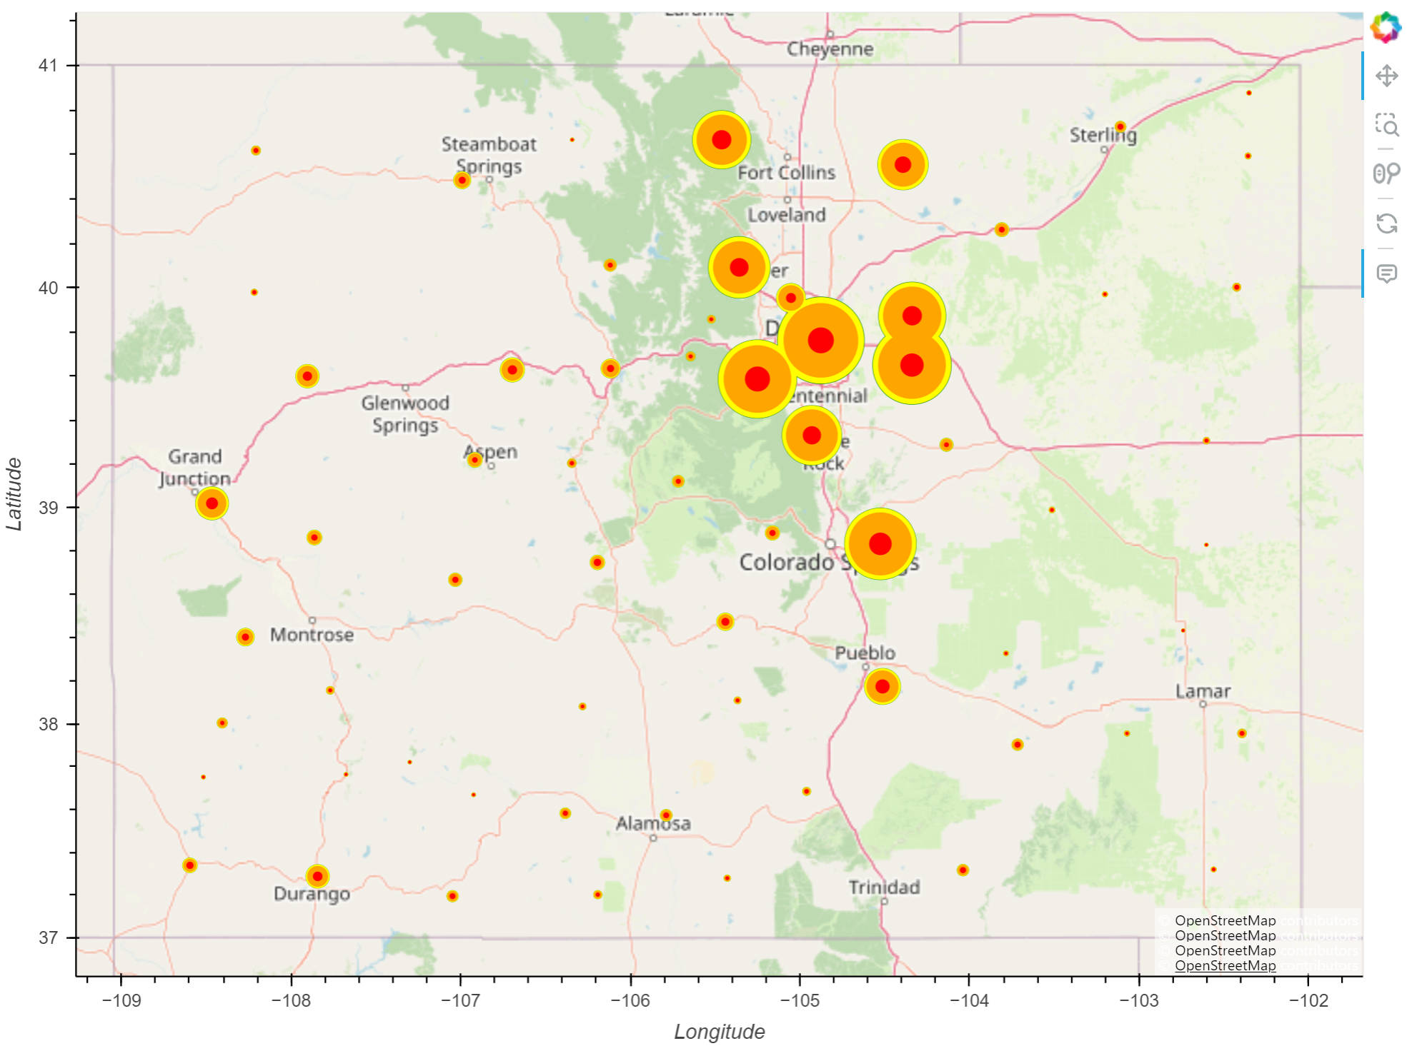
Notes:
Largest jump in vaccines administered between 2020 and 2021, slows down 2022 to 2023
Can barely even see the green behind the yellow

Slide 4
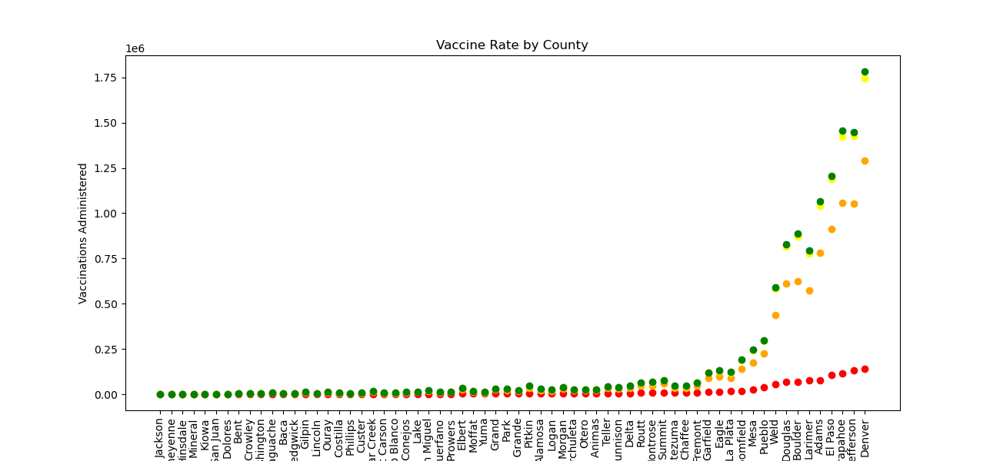
Notes:
Red is 2020, can see there isn’t much variance across the counties
2021, you can really see the jump larger counties take
Another large jump 2022
Very slight increase 2022 to 2023

Slide 5
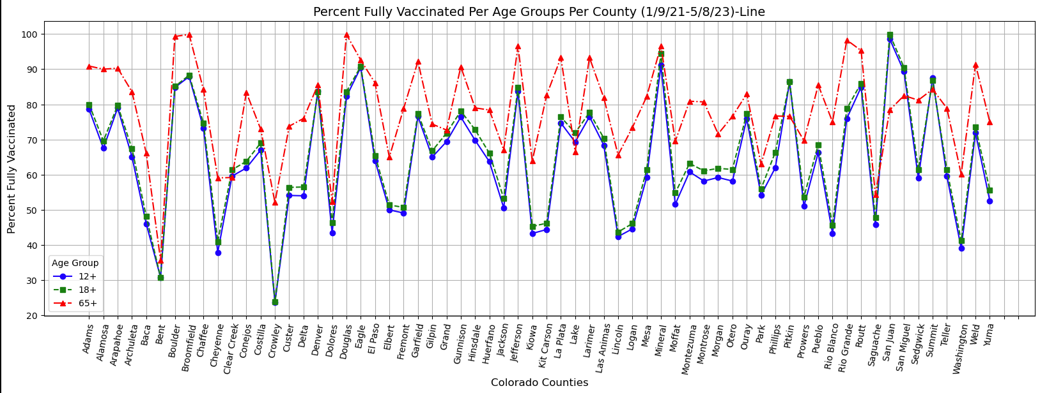
Vaccine Rate Per Age Group - Line
Notes:
Mineral vaccinate at almost an equal rate per age. While there were huge drops in 18+ for Crowley and Bent. Where less than half of those counties were vaccinated.

Slide 6
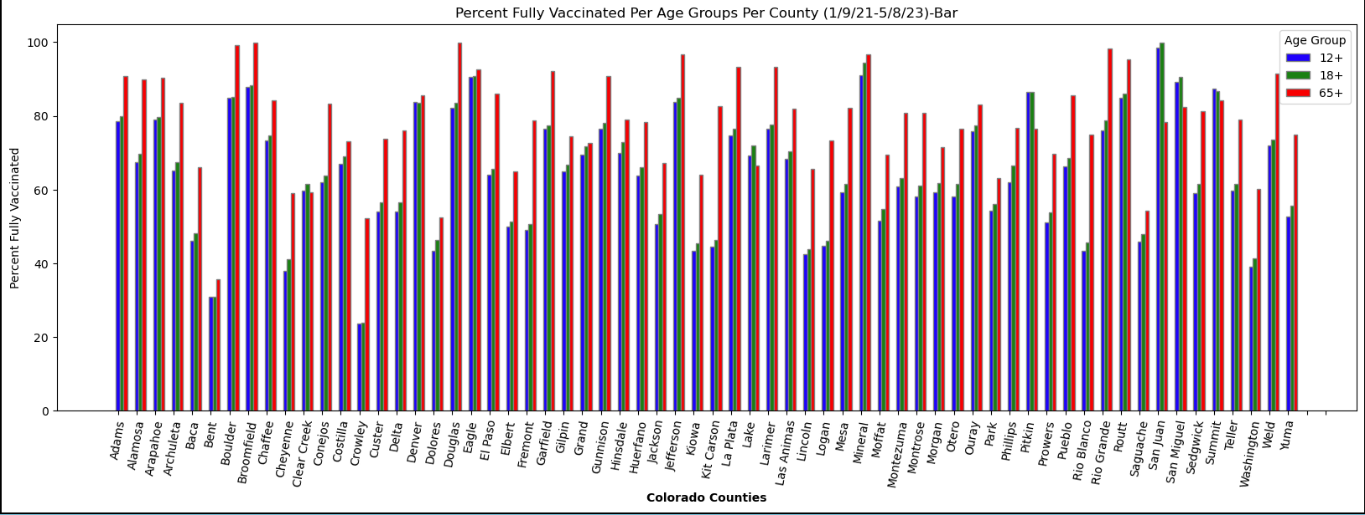
Vaccine Rates per Age Group - Bar

Slide 7
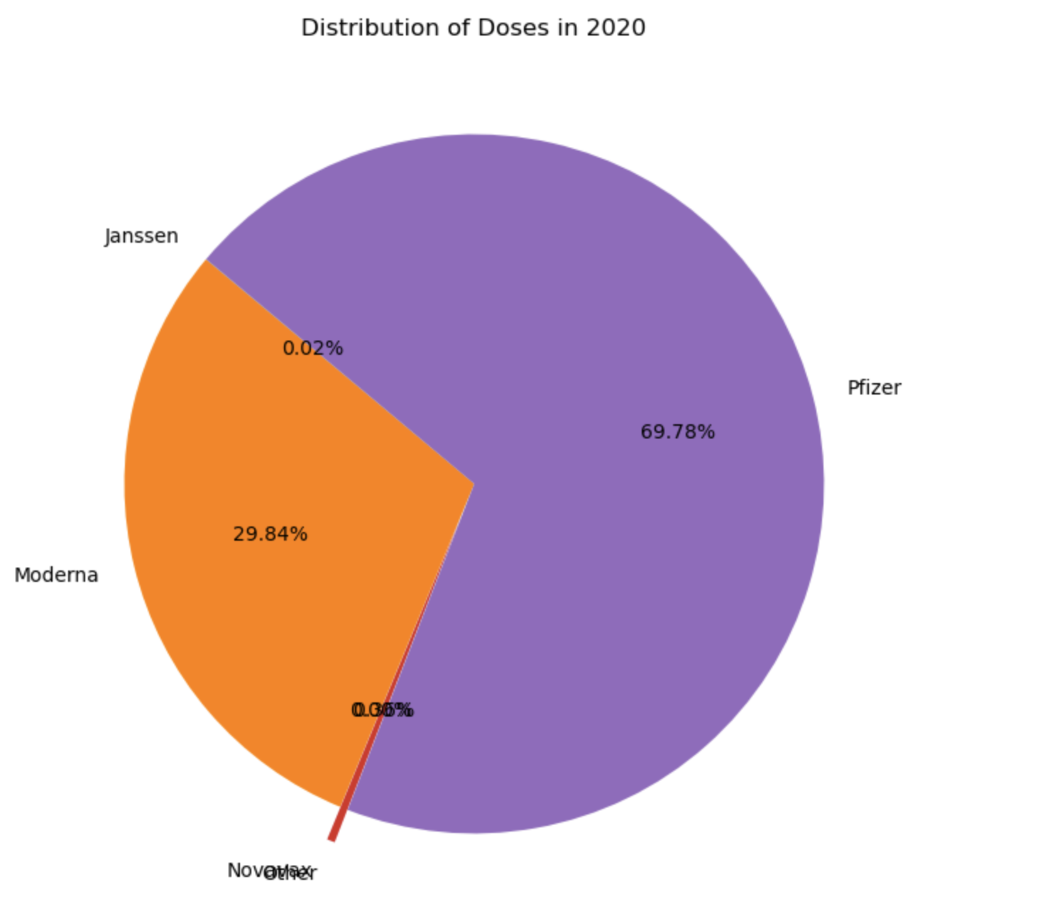
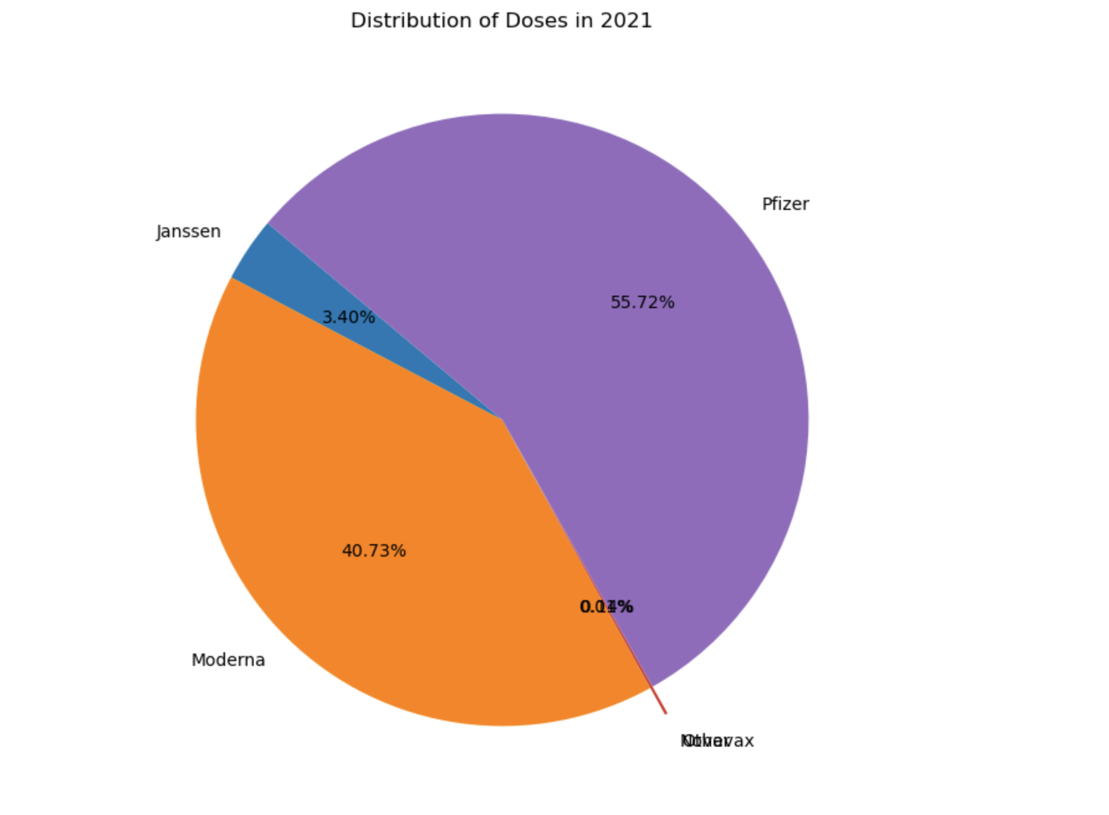
Vaccine Distribution By Year

Slide 8
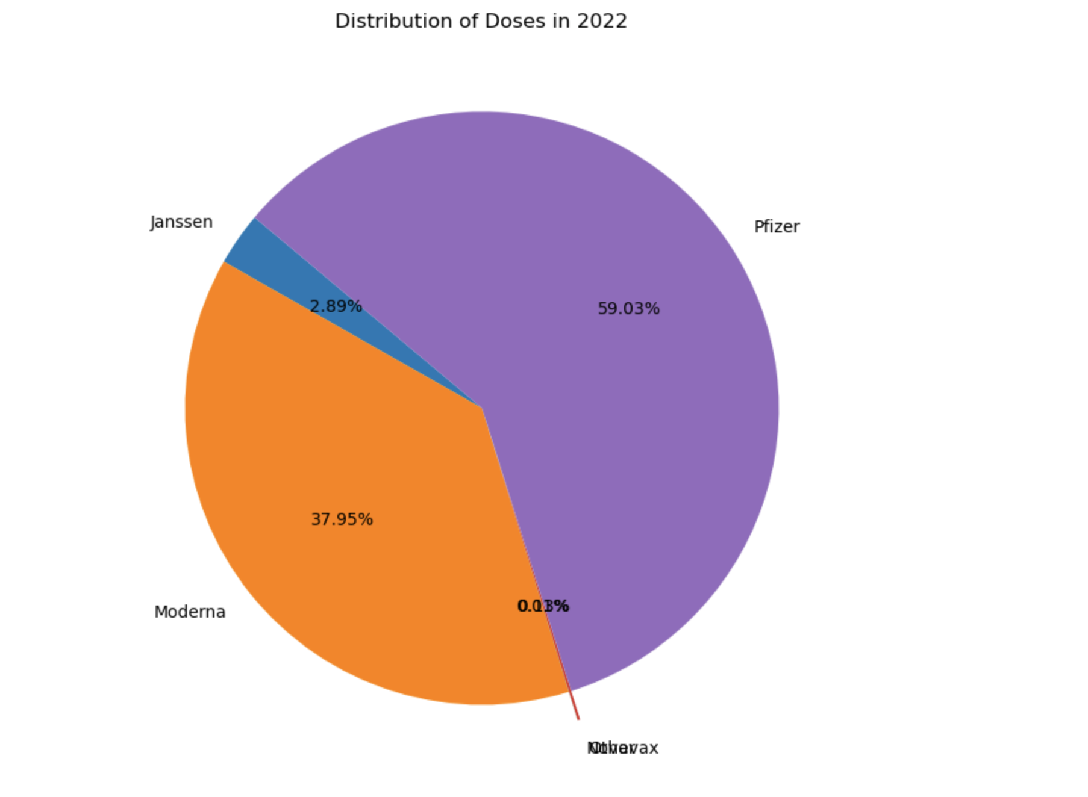
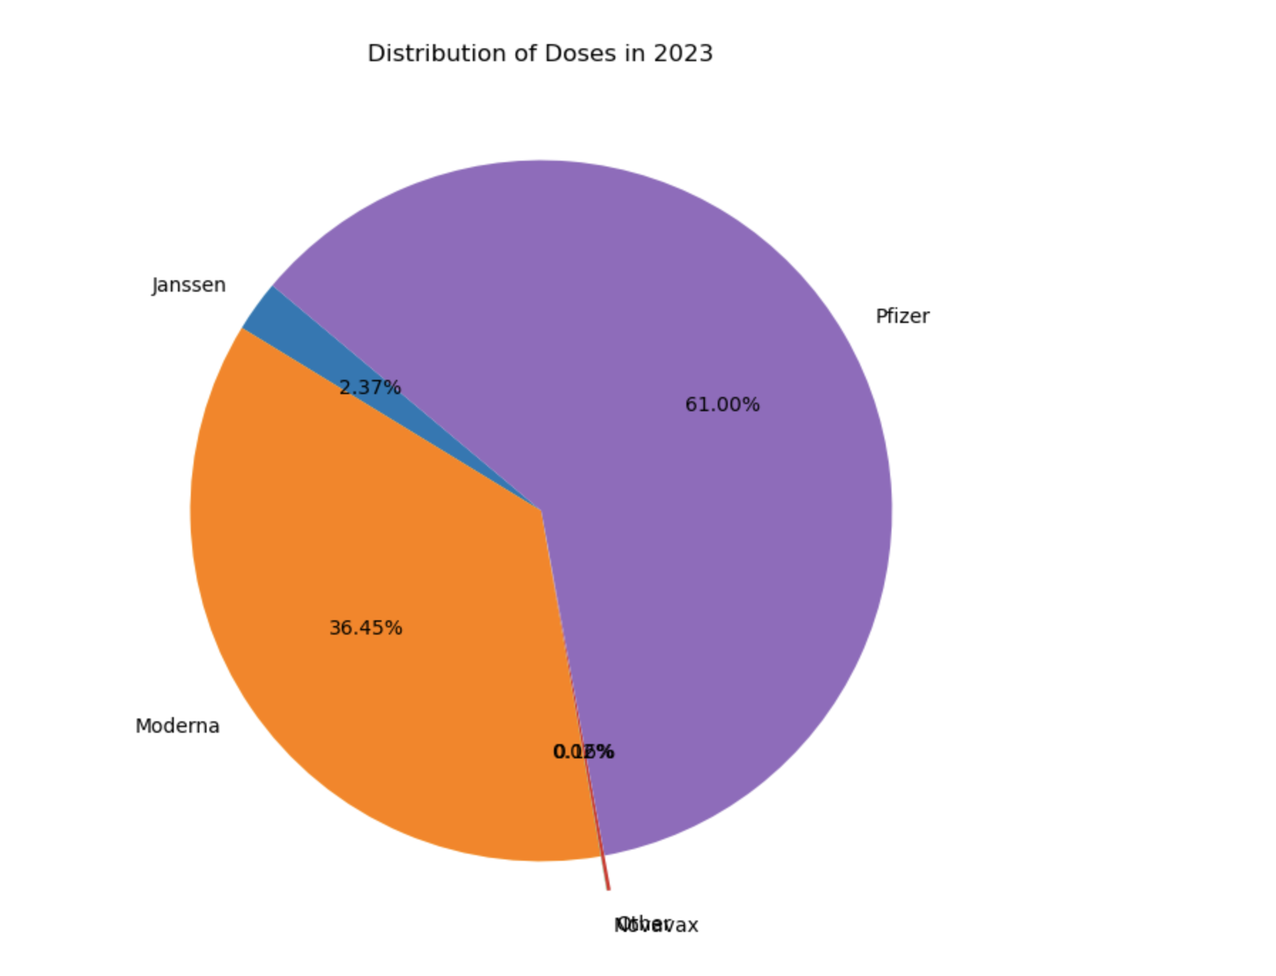

Slide 9
